Slide 1
What do we do as an imaging data scientist?

Slide 2
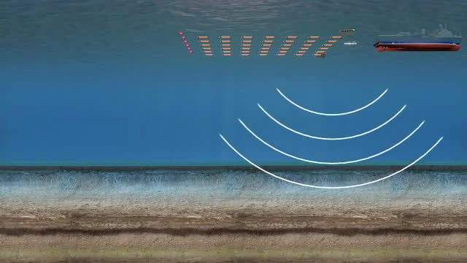
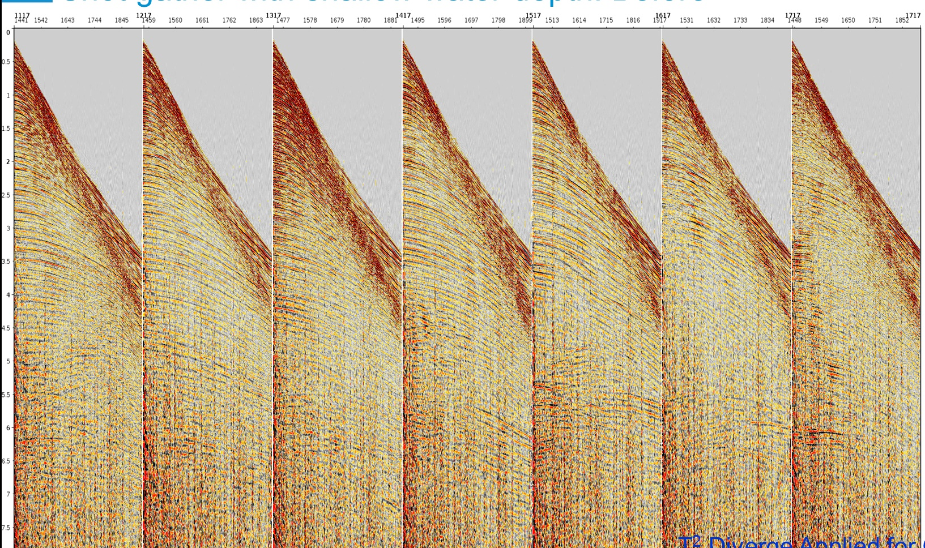
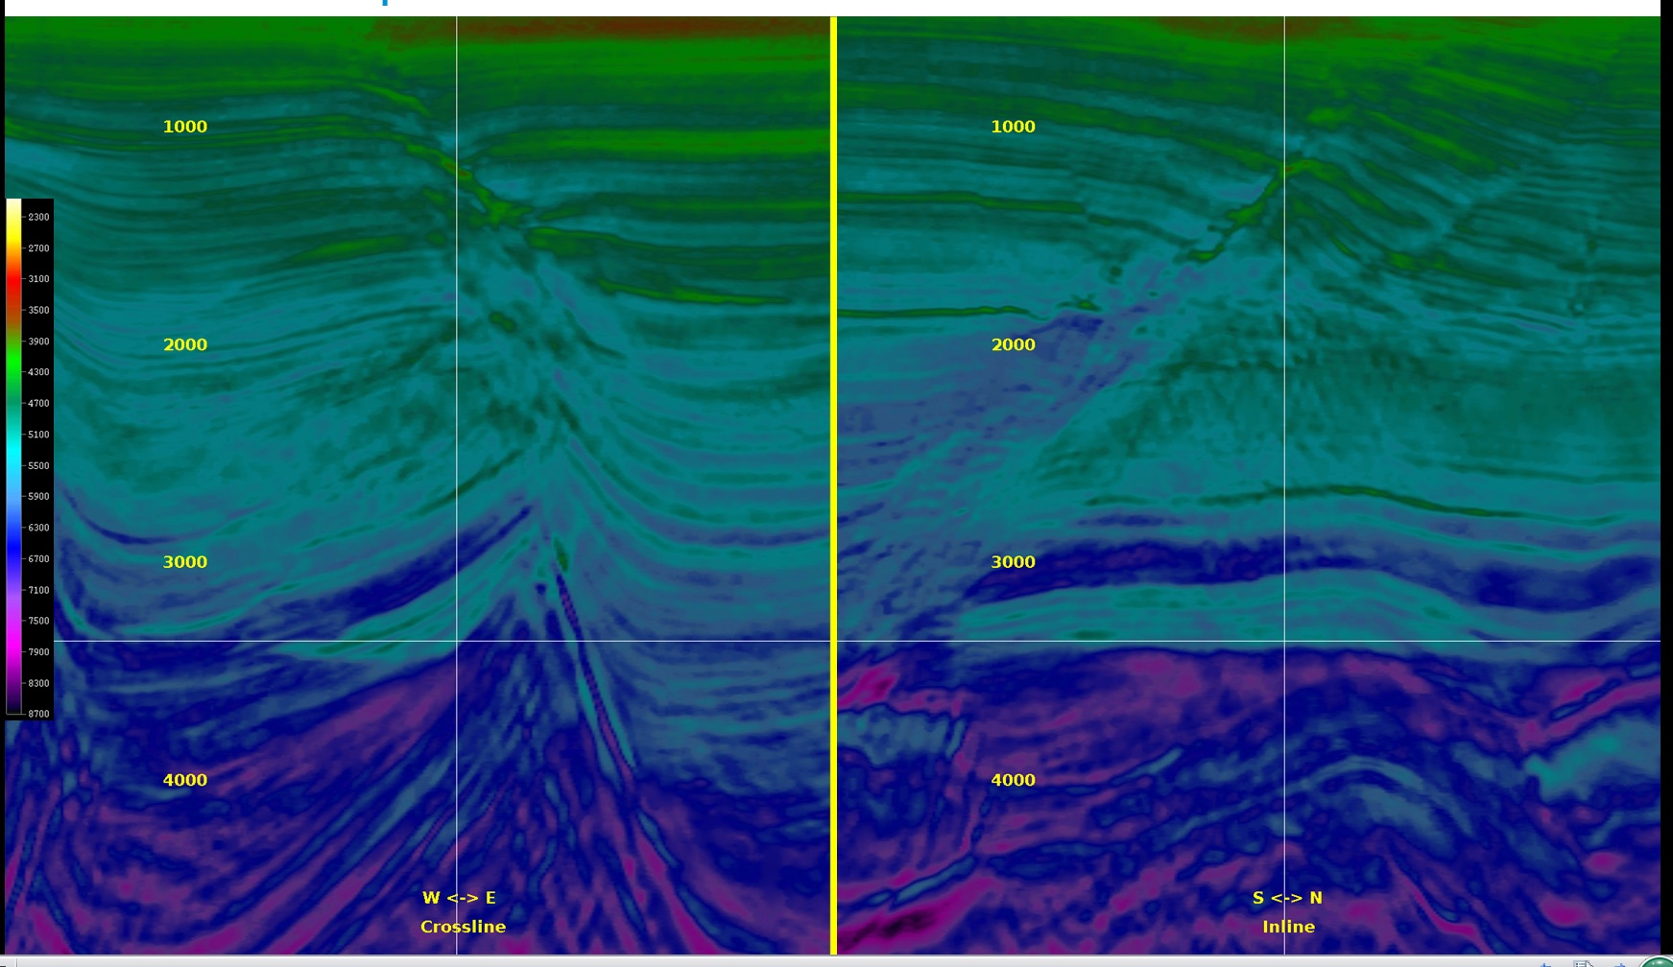
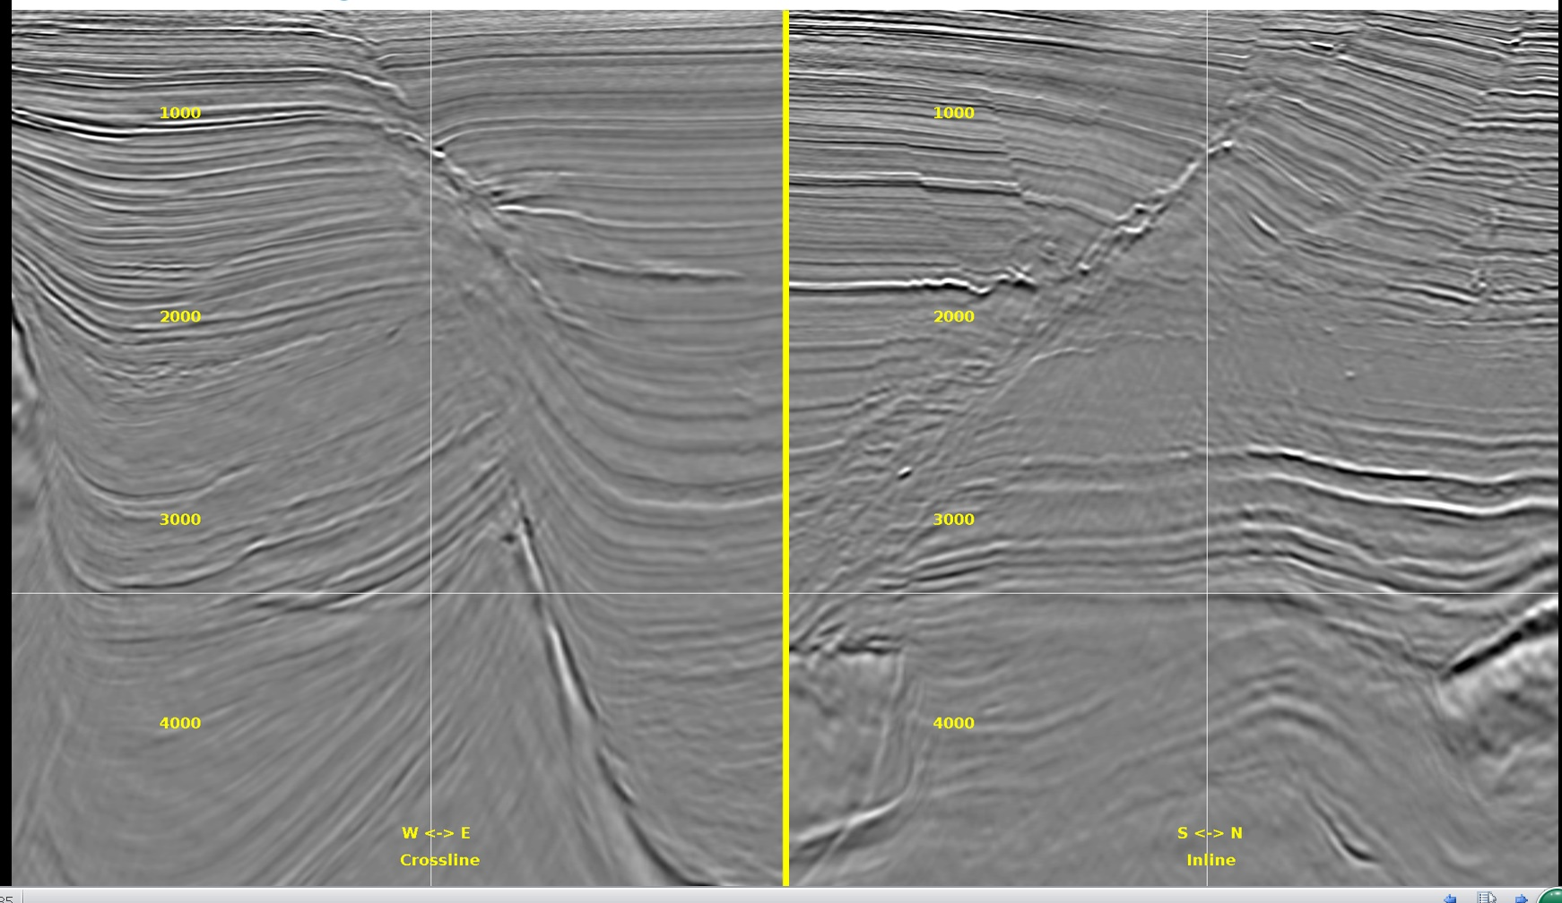
Our ultimate goal is to answer: Where is oil?
Data acquisition
Data processing
Let’s drill a well here. Good luck!
Data analysis
Data imaging

Slide 3
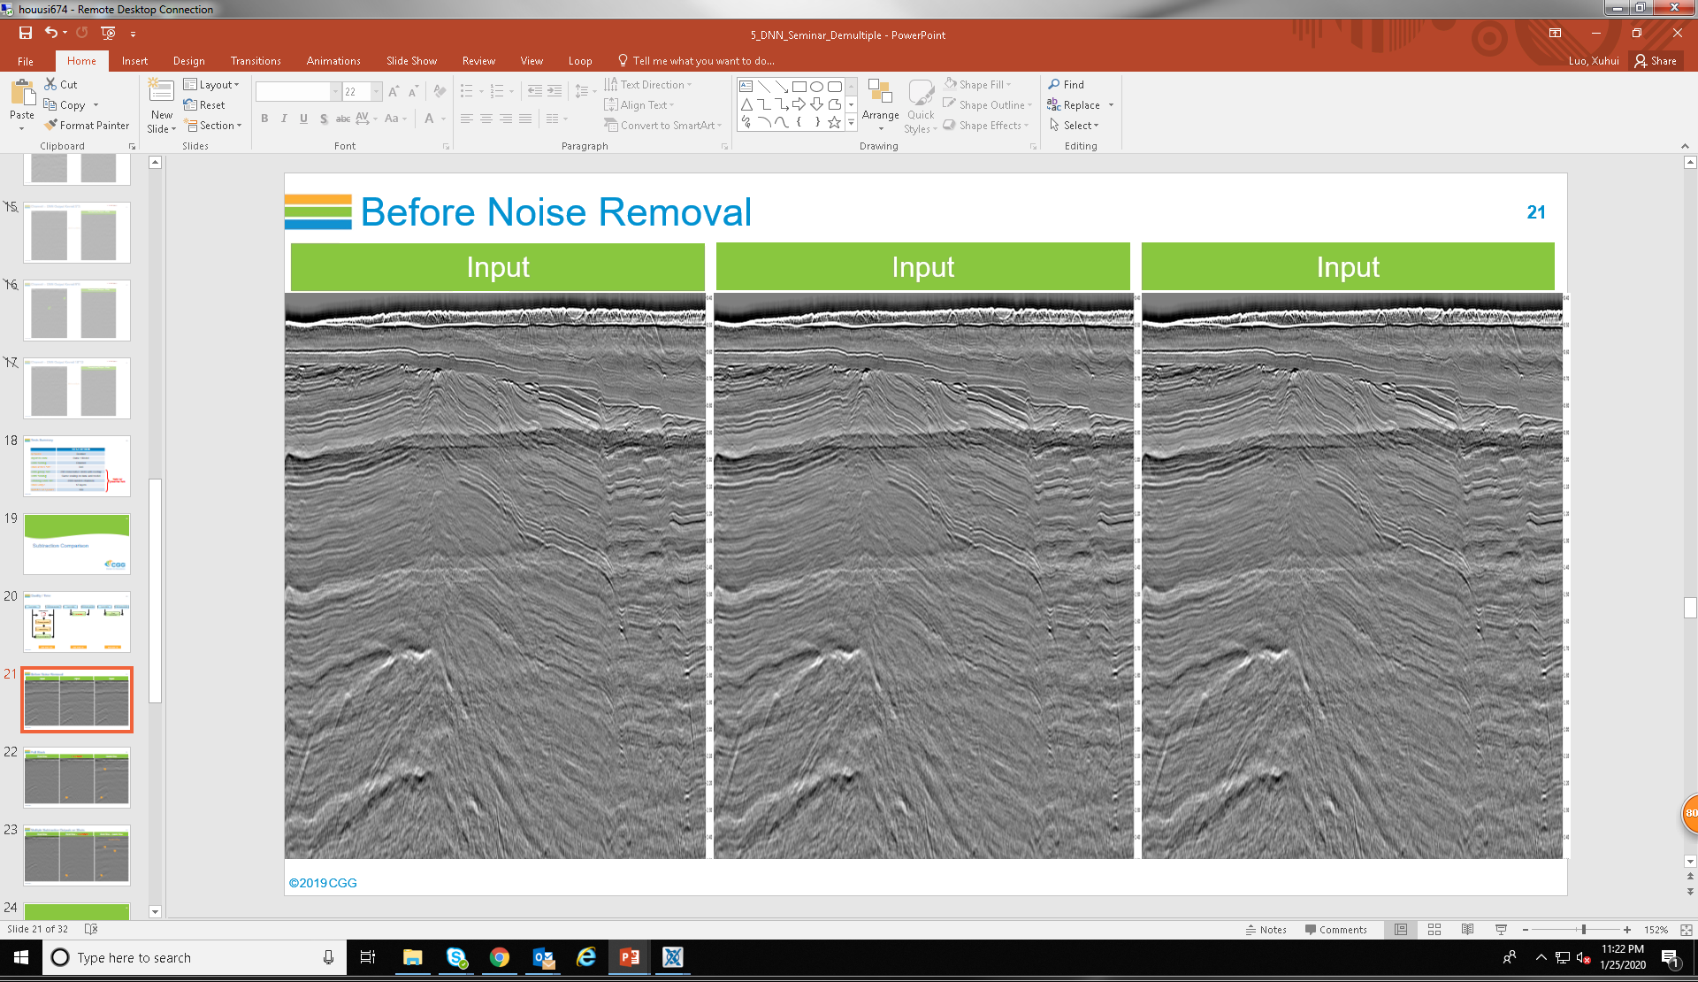
Application of DNN in Noise Removal

Slide 4

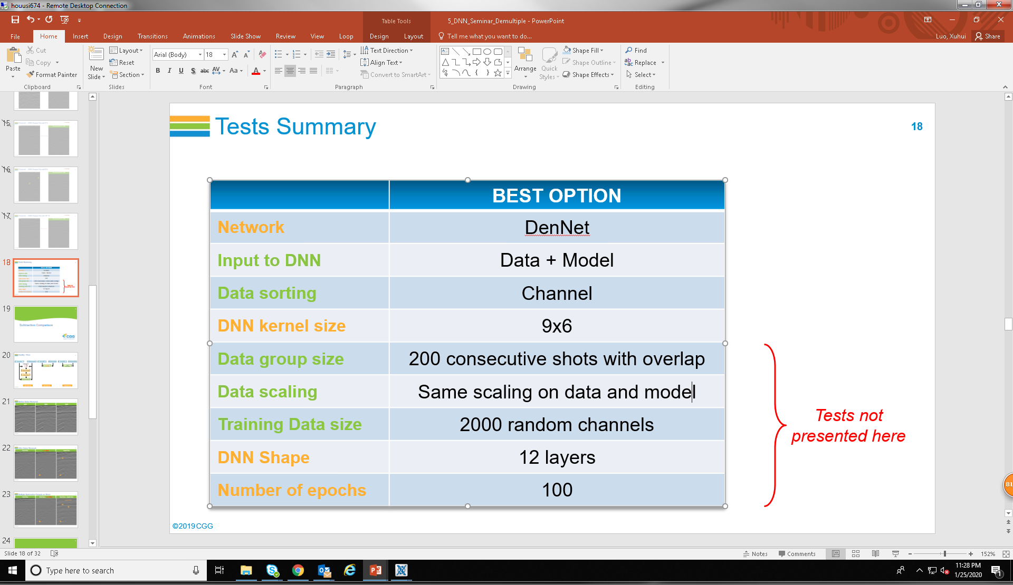
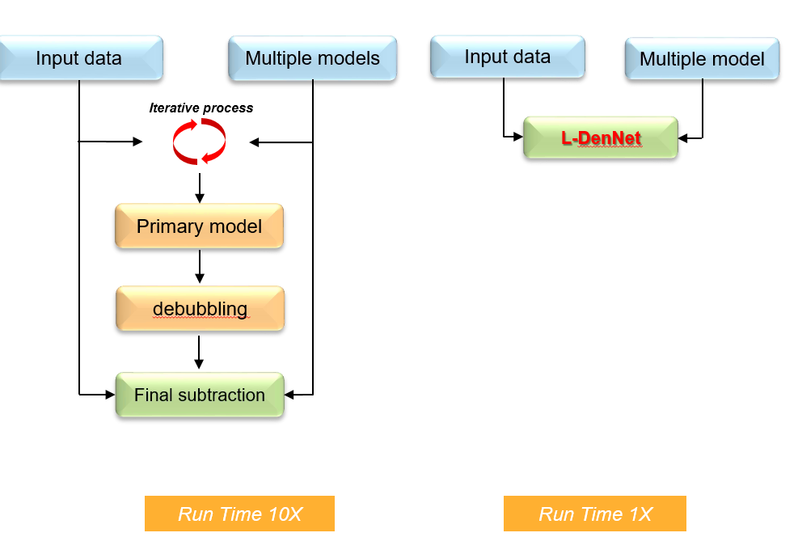
Application of DNN in Noise Removal

Slide 5
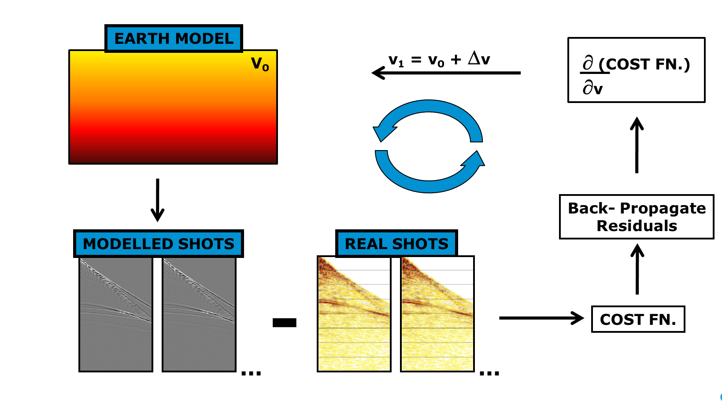
Application of pseudo neural network in inversion of earth velocity

Slide 6
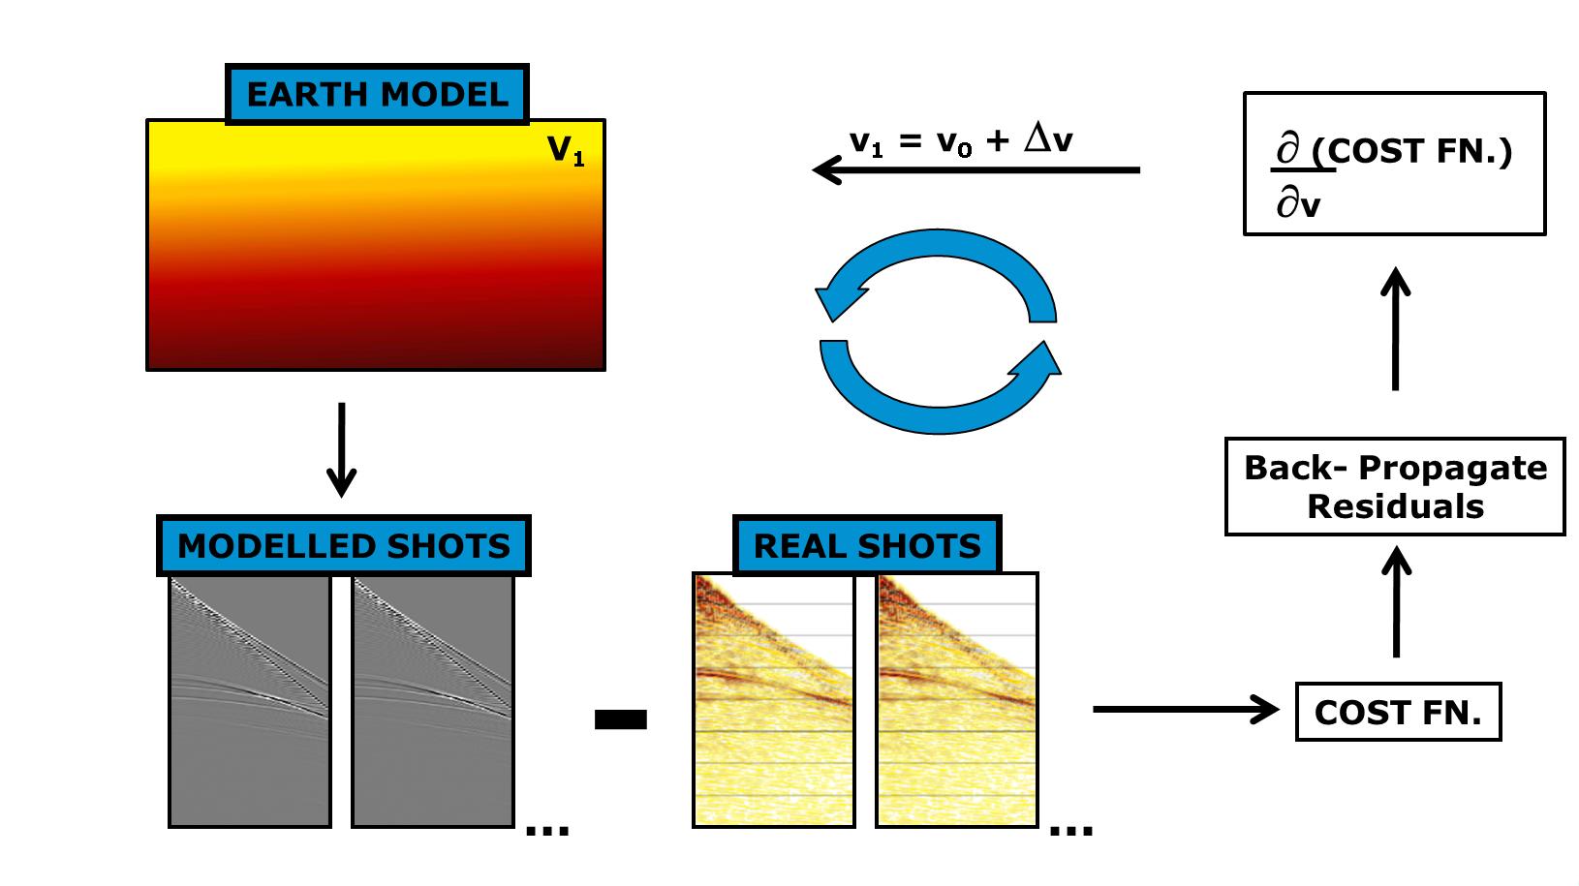
Application of pseudo neural network in inversion of earth velocity

Slide 7
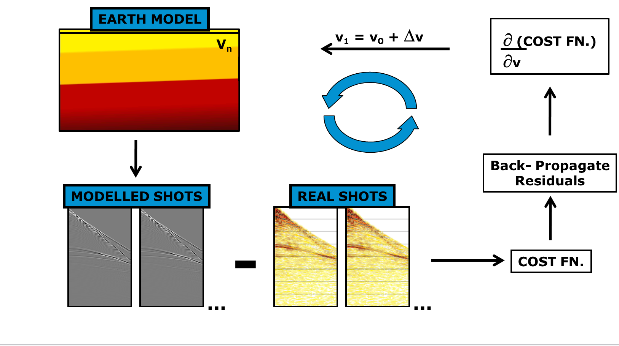
Application of pseudo neural network in inversion of earth velocity

